Slide 1
Introduction to Deep Learning
Shangsong Liang
Sun Yat-sen University

Slide 2
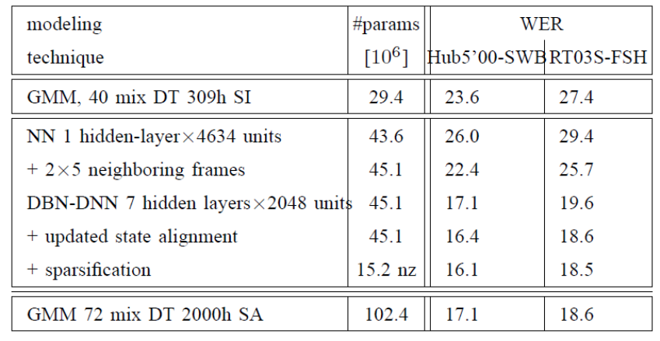
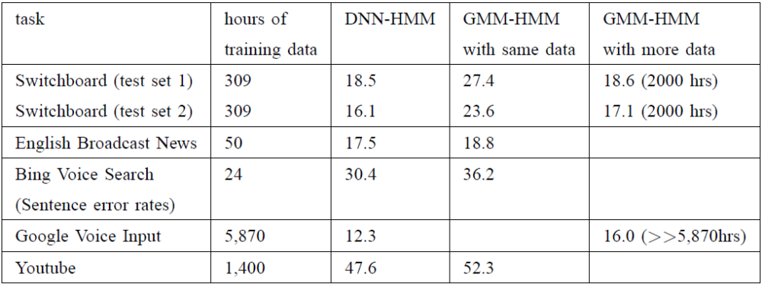
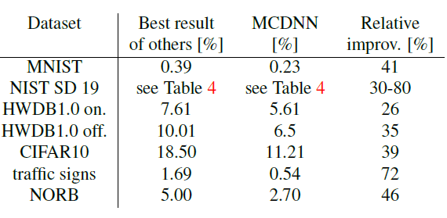
DL is providing breakthrough results in speech recognition and image classification …
From this Hinton et al 2012 paper:
http://static.googleusercontent.com/media/research.google.com/en//pubs/archive/38131.pdf
go here: http://yann.lecun.com/exdb/mnist/
From here:
http://people.idsia.ch/~juergen/cvpr2012.pdf

Slide 3
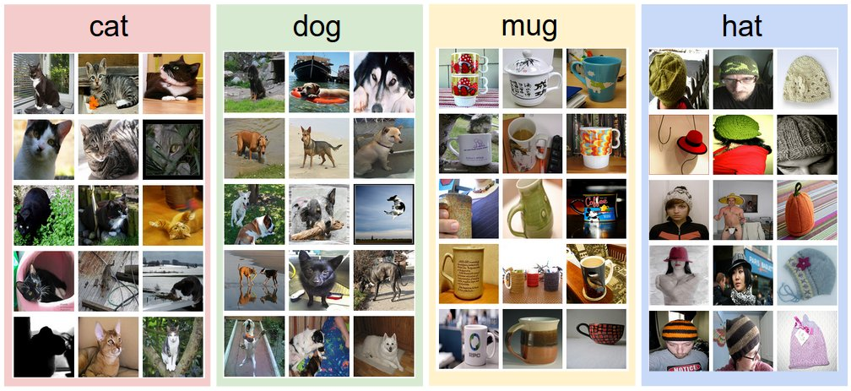
google inception network
Deep Learning is providing breakthrough results in speech recognition, image classification, etc.

Slide 4
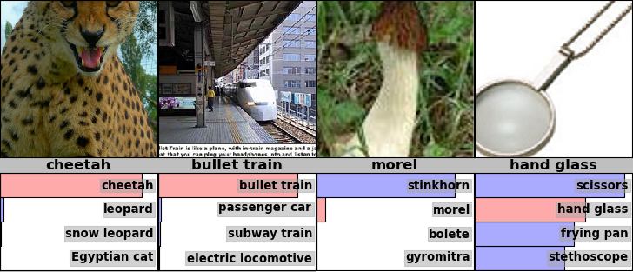
Examples from the test set (with the network’s guesses)

Slide 5
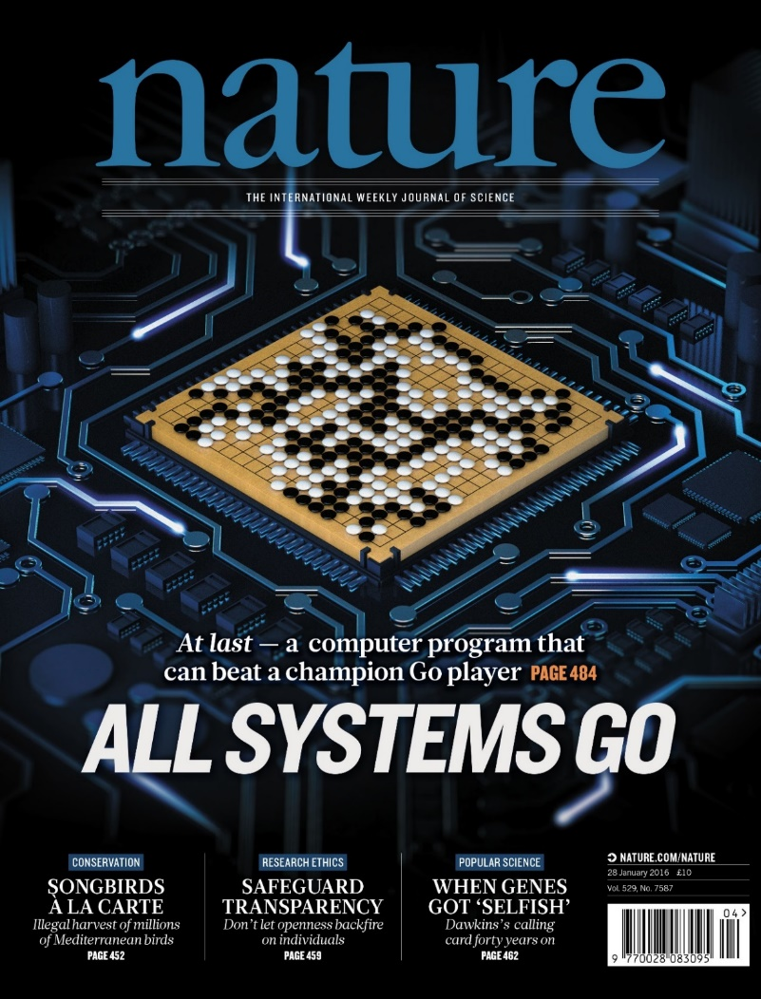
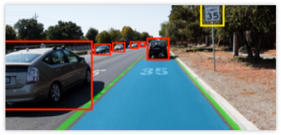
Video analyses and decision making

Slide 6
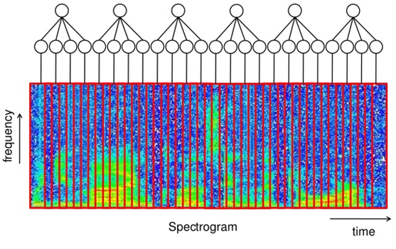
Speech recognition

Slide 7
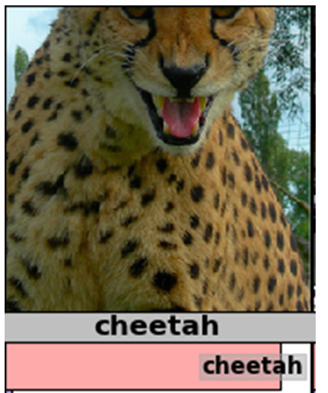
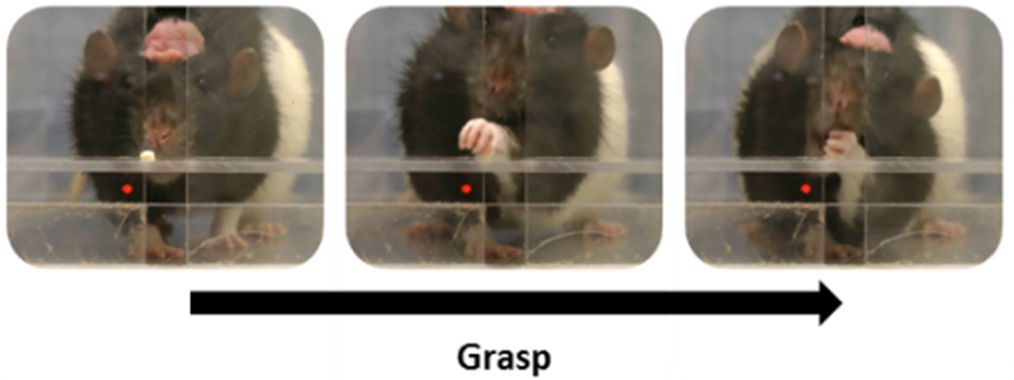
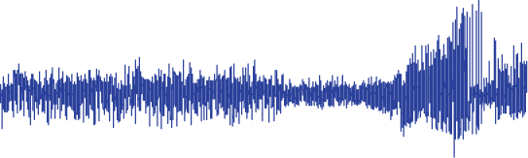
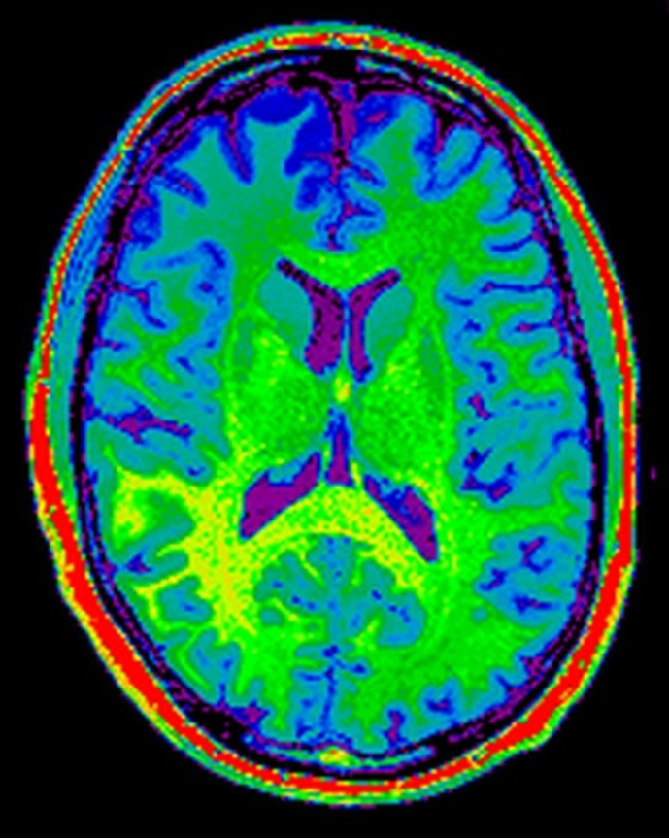
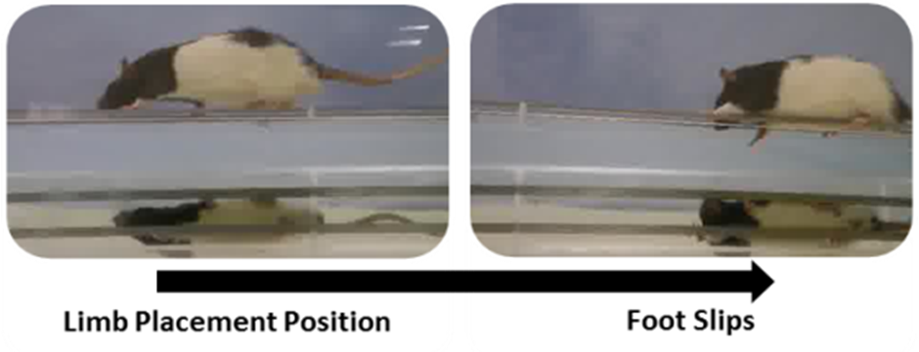
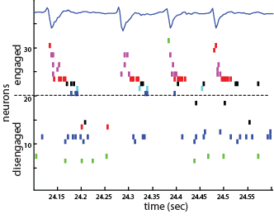
Neuroscience data is similar to other types of data
EEG / LFP
Spiking data
Ryait et al. & Luczak

Slide 8
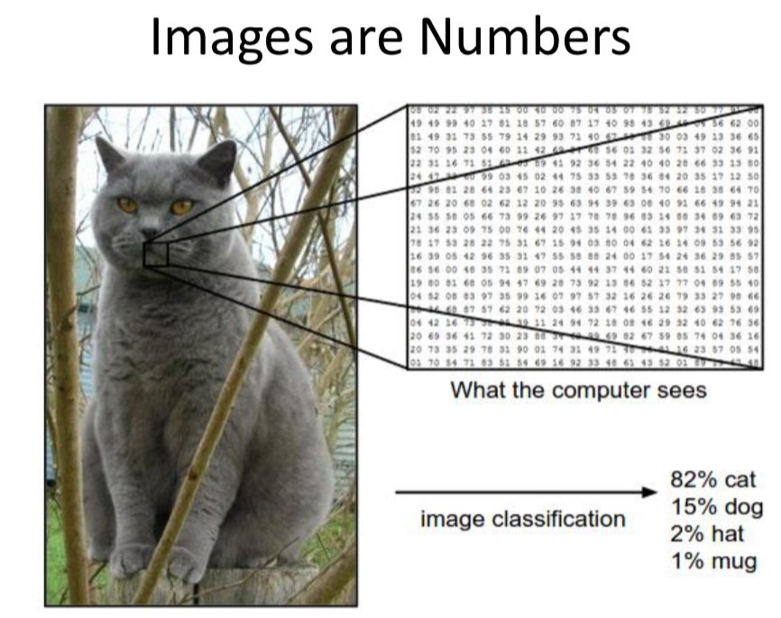

Slide 9
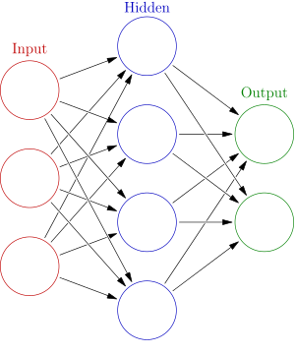
What is Artificial Neuronal Network?

Slide 10
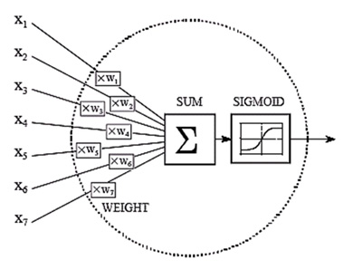
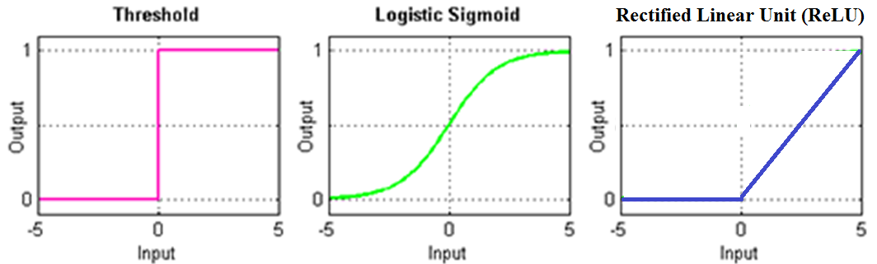
Artificial neural

Slide 11
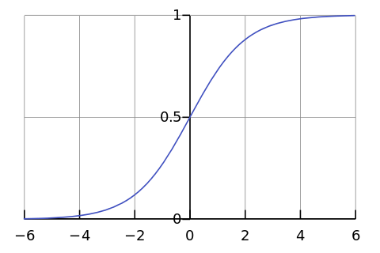

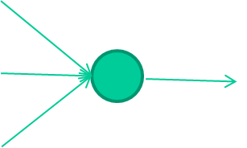
-0.06
W1
W2
f(x)
-2.5
W3
1.4

Slide 12
-0.06
2.7
-8.6
f(x)
-2.5
0.002
x = -0.06×2.7 + 2.5×8.6 + 1.4×0.002 = 21.34
1.4

Slide 13
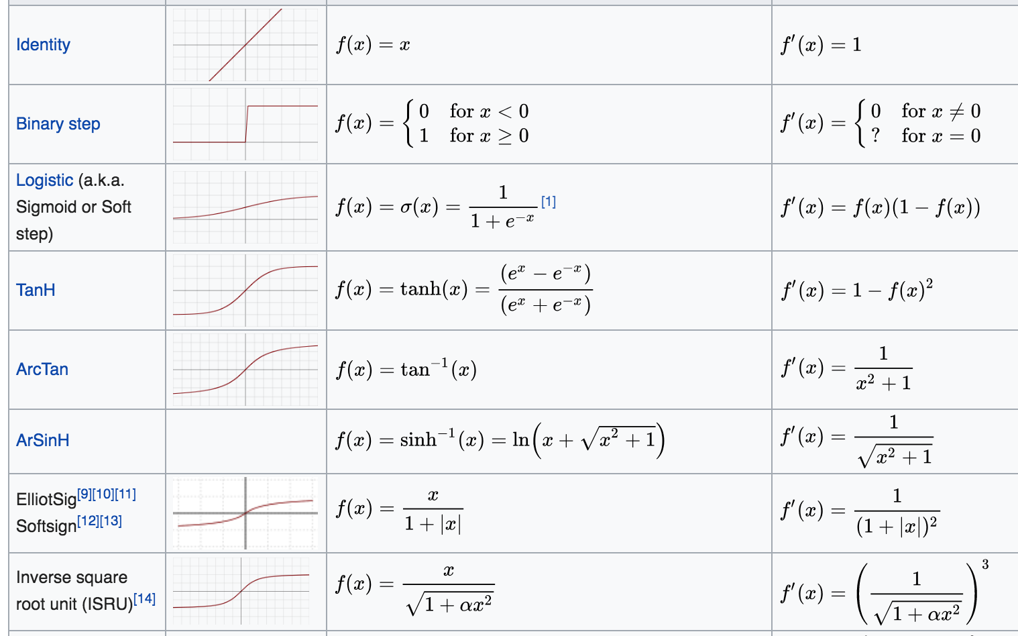
Activation function

Slide 14
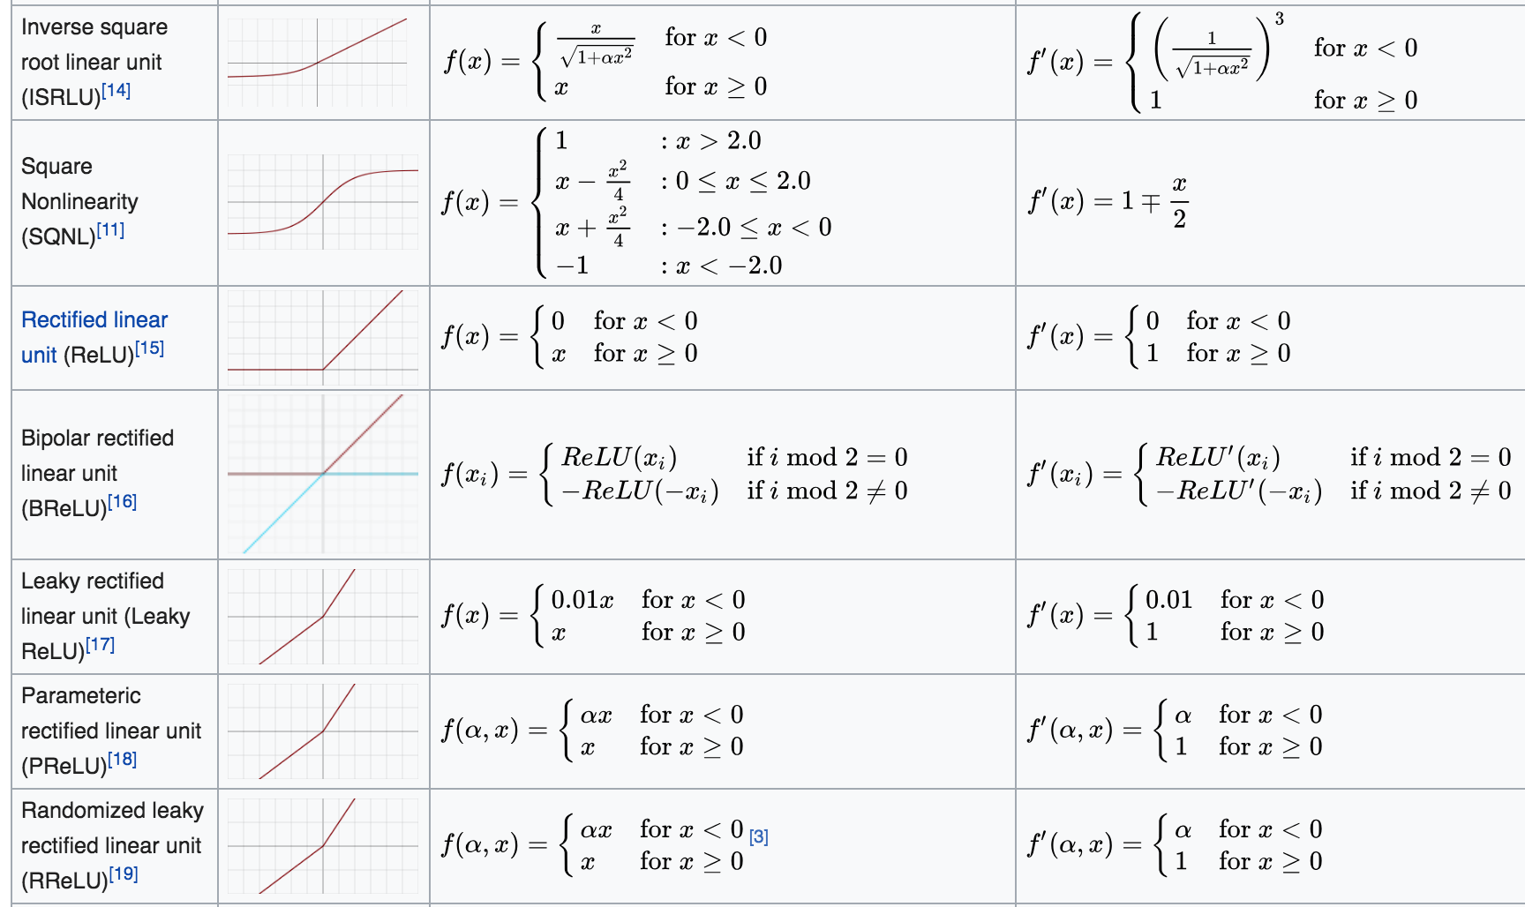
Activation function

Slide 15
So, 1. what exactly is deep learning ?
And, 2. why is it generally better than other methods on image, speech and certain other types of data?

Slide 16
So, 1. what exactly is deep learning ?
And, 2. why is it generally better than other methods on image, speech and certain other types of data?
The short answers
1. ‘Deep Learning’ means using a neural network
with several layers of nodes between input and output
2. the series of layers between input & output do
feature identification and processing in a series of stages,
just as our brains seem to.

Slide 17
hmmm… OK, but:
3. multilayer neural networks have been around for
25 years. What’s actually new?

Slide 18
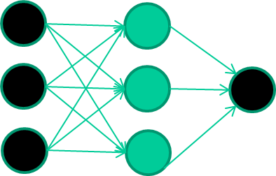
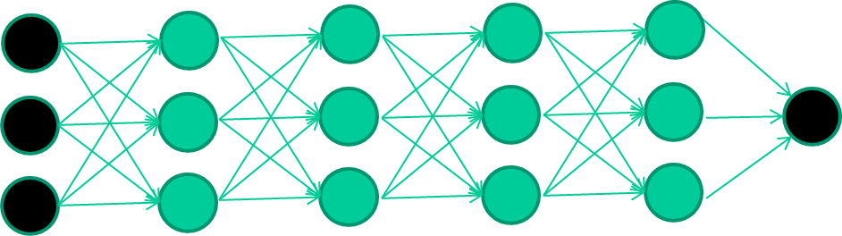
hmmm… OK, but:
3. multilayer neural networks have been around for
25 years. What’s actually new?
we have always had good algorithms for learning the
weights in networks with 1 hidden layer
but these algorithms are not good at learning the weights for
networks with more hidden layers
what’s new is: algorithms for training many-later networks

Slide 19
longer answers
reminder/quick-explanation of how neural network weights are learned;
the idea of unsupervised feature learning (why ‘intermediate features’ are important for difficult classification tasks, and how NNs seem to naturally learn them)
The ‘breakthrough’ – the simple trick for training Deep neural networks

Slide 20
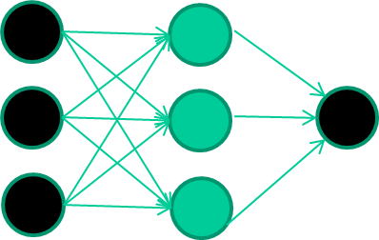
A dataset
Fields class
1.4 2.7 1.9 0
3.8 3.4 3.2 0
6.4 2.8 1.7 1
4.1 0.1 0.2 0
etc …

Slide 21
Training the neural network
Fields class
1.4 2.7 1.9 0
3.8 3.4 3.2 0
6.4 2.8 1.7 1
4.1 0.1 0.2 0
etc …

Slide 22
Training data
Fields class
1.4 2.7 1.9 0
3.8 3.4 3.2 0
6.4 2.8 1.7 1
4.1 0.1 0.2 0
etc …
Initialise with random weights

Slide 23
Training data
Fields class
1.4 2.7 1.9 0
3.8 3.4 3.2 0
6.4 2.8 1.7 1
4.1 0.1 0.2 0
etc …
Present a training pattern
1.4
2.7
1.9

Slide 24
Training data
Fields class
1.4 2.7 1.9 0
3.8 3.4 3.2 0
6.4 2.8 1.7 1
4.1 0.1 0.2 0
etc …
Feed it through to get output
1.4
2.7 0.8
1.9

Slide 25
Training data
Fields class
1.4 2.7 1.9 0
3.8 3.4 3.2 0
6.4 2.8 1.7 1
4.1 0.1 0.2 0
etc …
Compare with target output
1.4
2.7 0.8
0
1.9 error 0.8

Slide 26


Training data
Fields class
1.4 2.7 1.9 0
3.8 3.4 3.2 0
6.4 2.8 1.7 1
4.1 0.1 0.2 0
etc …
Adjust weights based on error
1.4
2.7 0.8
0
1.9 error 0.8

Slide 27
Training data
Fields class
1.4 2.7 1.9 0
3.8 3.4 3.2 0
6.4 2.8 1.7 1
4.1 0.1 0.2 0
etc …
Present a training pattern
6.4
2.8
1.7

Slide 28
Training data
Fields class
1.4 2.7 1.9 0
3.8 3.4 3.2 0
6.4 2.8 1.7 1
4.1 0.1 0.2 0
etc …
Feed it through to get output
6.4
2.8 0.9
1.7

Slide 29
Training data
Fields class
1.4 2.7 1.9 0
3.8 3.4 3.2 0
6.4 2.8 1.7 1
4.1 0.1 0.2 0
etc …
Compare with target output
6.4
2.8 0.9
1
1.7 error -0.1

Slide 30
Training data
Fields class
1.4 2.7 1.9 0
3.8 3.4 3.2 0
6.4 2.8 1.7 1
4.1 0.1 0.2 0
etc …
Adjust weights based on error
6.4
2.8 0.9
1
1.7 error -0.1

Slide 31
Training data
Fields class
1.4 2.7 1.9 0
3.8 3.4 3.2 0
6.4 2.8 1.7 1
4.1 0.1 0.2 0
etc …
And so on ….
6.4
2.8 0.9
1
1.7 error -0.1
Repeat this thousands, maybe millions of times – each time
taking a random training instance, and making slight
weight adjustments
Algorithms for weight adjustment are designed to make
changes that will reduce the error

Slide 32
The decision boundary perspective…
Initial random weights

Slide 33
The decision boundary perspective…
Present a training instance / adjust the weights

Slide 34
The decision boundary perspective…
Present a training instance / adjust the weights

Slide 35
The decision boundary perspective…
Present a training instance / adjust the weights

Slide 36
The decision boundary perspective…
Present a training instance / adjust the weights

Slide 37
The decision boundary perspective…
Eventually ….

Slide 38
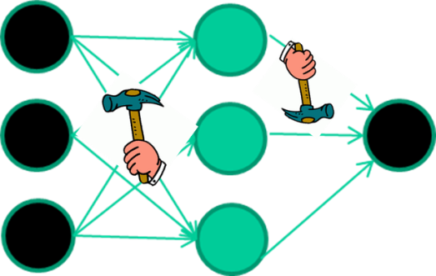
The point I am trying to make
weight-learning algorithms for NNs are dumb
they work by making thousands and thousands of tiny adjustments, each making the network do better at the most recent pattern, but perhaps a little worse on many others
but, by dumb luck, eventually this tends to be good enough to
learn effective classifiers for many real applications

Slide 39
Some other points
Detail of a standard NN weight learning algorithm – later
If f(x) is non-linear, a network with 1 hidden layer can, in theory, learn perfectly any classification problem. A set of weights exists that can produce the targets from the inputs. The problem is finding them.

Slide 40
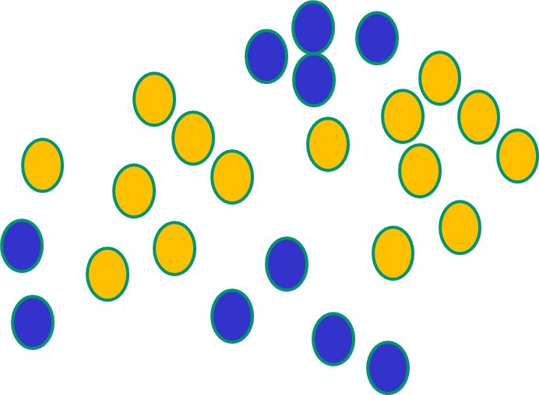
Some other ‘by the way’ points
If f(x) is linear, the NN can only draw straight decision boundaries (even if there are many layers of units)

Slide 41
Some other ‘by the way’ points
NNs use nonlinear f(x) so they
can draw complex boundaries,
but keep the data unchanged

Slide 42
Some other ‘by the way’ points
NNs use nonlinear f(x) so they SVMs only draw straight lines,
can draw complex boundaries, but they transform the data first
but keep the data unchanged in a way that makes that OK

Slide 43
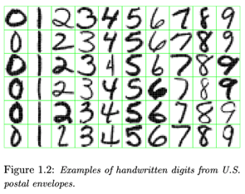

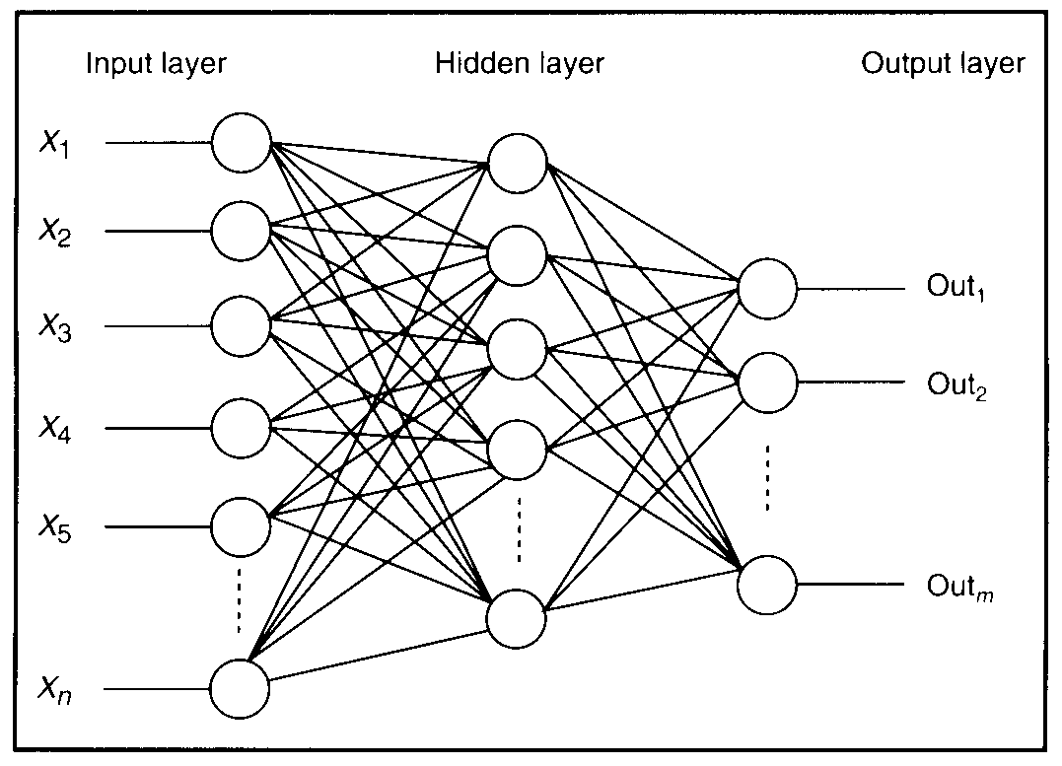
Feature detectors

Slide 44
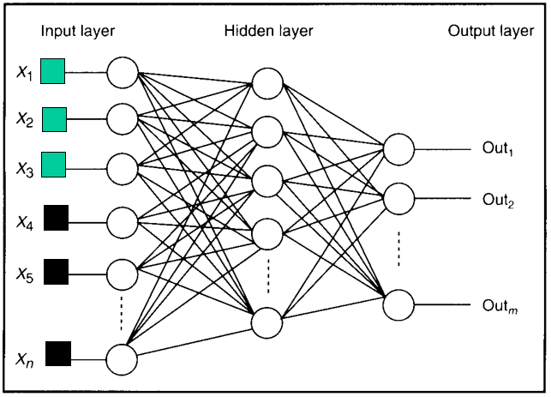
Feature detectors

Slide 45
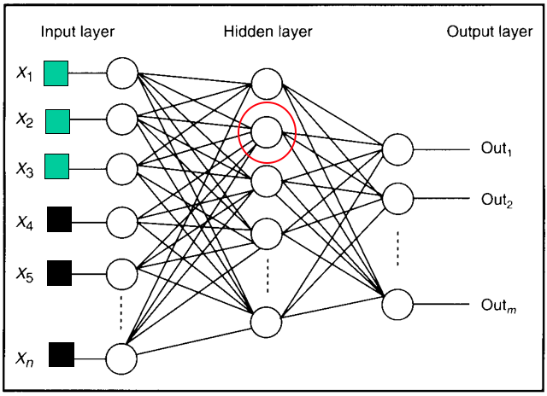
what is this unit doing?

Slide 46
Hidden layer units become self-organised feature detectors
1 5 10 15 20 25 …
…
1
strong +ve weight
low/zero weight
63

Slide 47
What does this unit detect?
1 5 10 15 20 25 …
…
1
strong +ve weight
low/zero weight
63

Slide 48
What does this unit detect?
1 5 10 15 20 25 …
…
1
strong +ve weight
low/zero weight
it will send strong signal for a horizontal
line in the top row, ignoring everywhere else
63

Slide 49
What does this unit detect?
1 5 10 15 20 25 …
…
1
strong +ve weight
low/zero weight
63

Slide 50
What does this unit detect?
1 5 10 15 20 25 …
…
1
strong +ve weight
low/zero weight
Strong signal for a dark area in the top left
corner
63

Slide 51
What features might you expect a good NN
to learn, when trained with data like this?

Slide 52
vertical lines
1
63

Slide 53
Horizontal lines
1
63

Slide 54
Small circles
1
63

Slide 55
Small circles
1
But what about position invariance ???
our example unit detectors were tied to
specific parts of the image
63

Slide 56
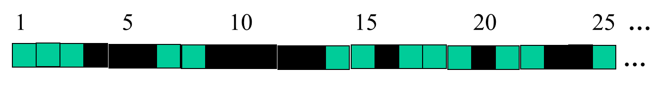
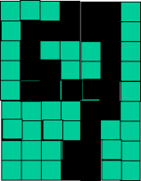
successive layers can learn higher-level features …
detect lines in
Specific positions
etc …
Higher level detetors
( horizontal line,
“RHS vertical lune”
“upper loop”, etc…
etc …
v

Slide 57
successive layers can learn higher-level features …
detect lines in
Specific positions
etc …
Higher level detetors
( horizontal line,
“RHS vertical lune”
“upper loop”, etc…
etc …
v
What does this unit detect?

Slide 58
So: multiple layers make sense

Slide 59
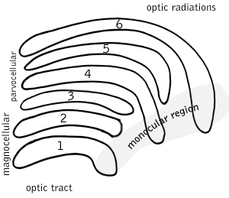
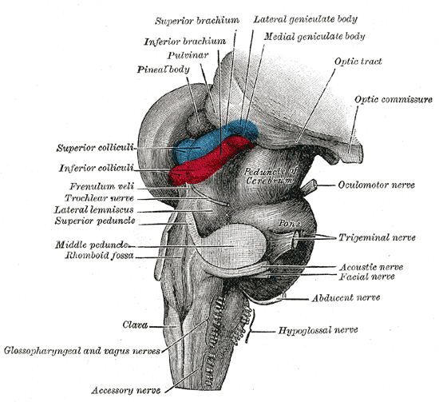
So: multiple layers make sense
Your brain works that way

Slide 60
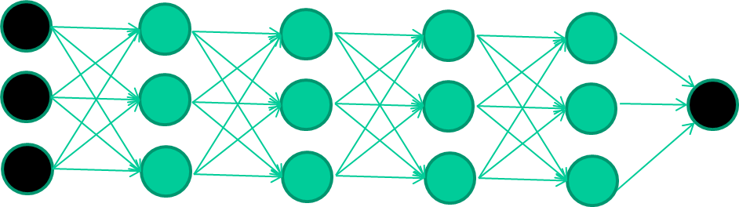
So: multiple layers make sense
Many-layer neural network architectures should be capable of learning the true underlying features and ‘feature logic’, and therefore generalise very well …

Slide 61


But, until very recently, our weight-learning algorithms simply did not work on multi-layer architectures

Slide 62
Along came deep learning …

Slide 63
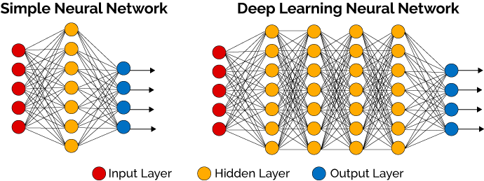
What is deep learning ?
A network with 1 hidden layer can, in theory, learn perfectly any classification problem. A set of weights exists that can produce the targets from the inputs. The problem is finding them.

Slide 64
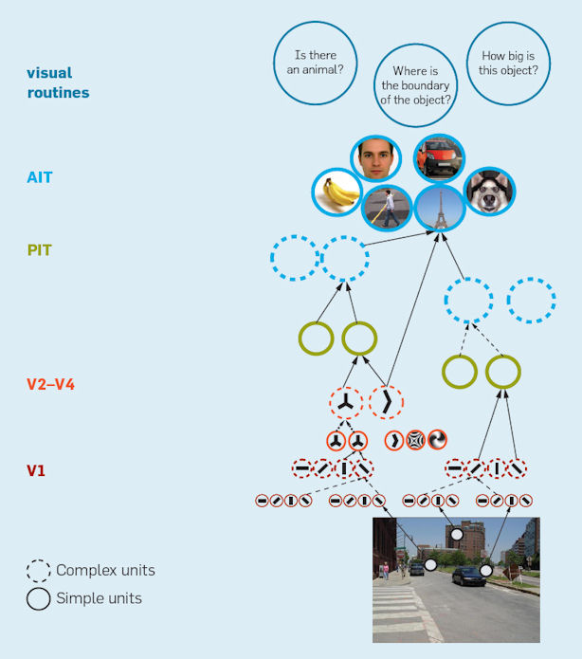
Hierarchical models
Riesenhuber & Poggio. Nature Neurosci 1999

Slide 65
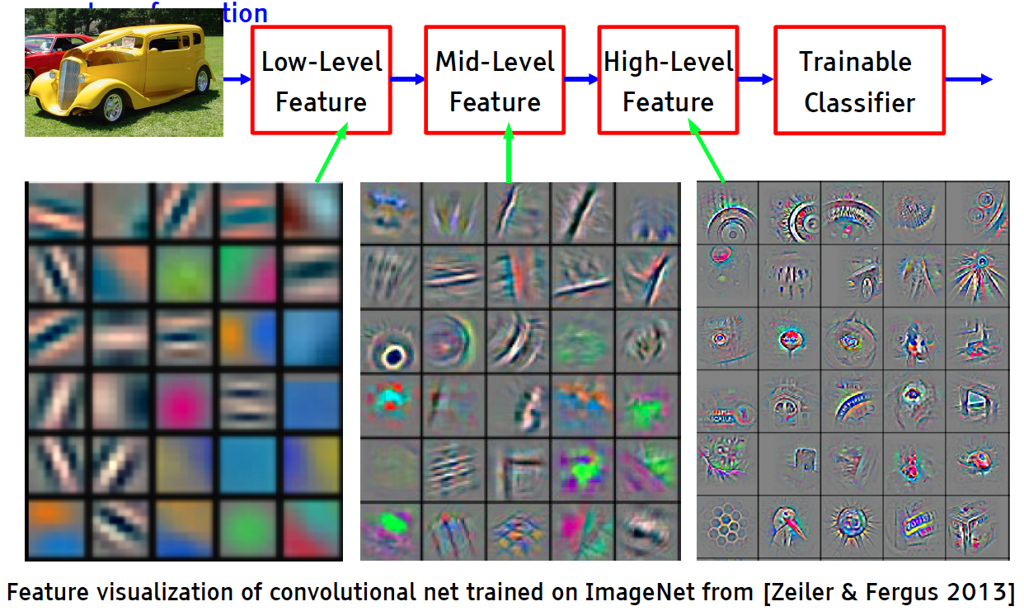
Deep Learning = Learning Hierarchical Representations

Slide 66
Convolutional Networks (ConvNet or CNN)
(currently the dominant approach for neural networks)
Use many different copies of the same feature detector with different positions.
  Replication greatly reduces the number of free parameters to be learned.
Use several different feature types, each with its own map of replicated detectors.
  Allows each patch of image to be represented in several ways.

Slide 67
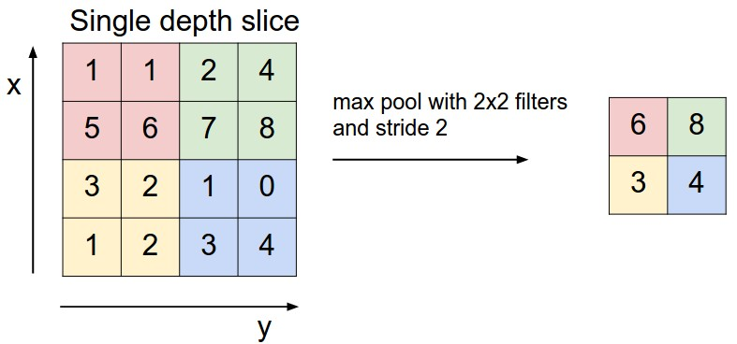
CNN Architecture: Pooling Layer
Pooling partitions the input image into a set of non-overlapping rectangles and, for each such sub-region, outputs the maximum value of the features in that region.
Intuition: to progressively reduce the spatial size of the representation to reduce the amount of parameters and computation in the network, and hence to also control overfitting
9
0
3
9
0

Slide 68
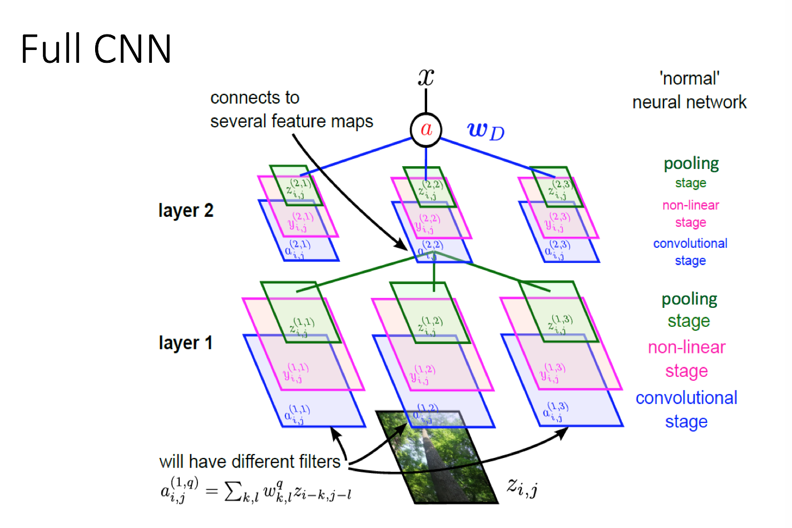

Slide 69
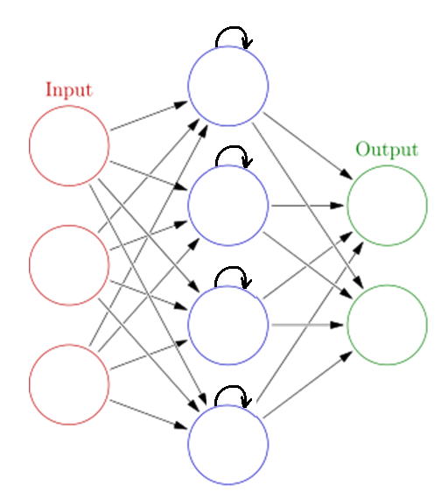
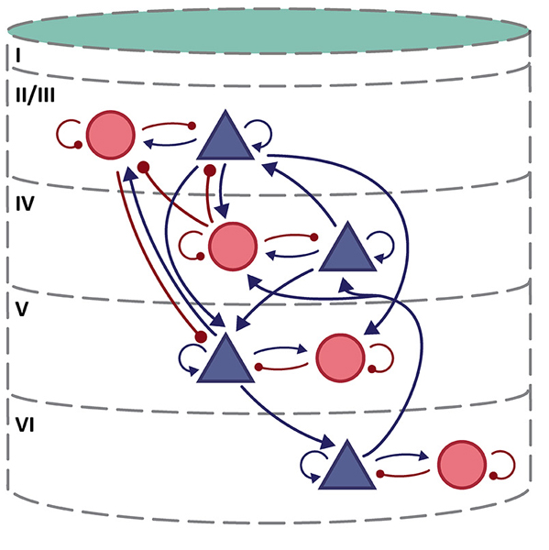
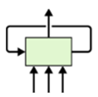
Recurrent Neural Networks and LSTM neurons
Potjans and Diesmann (2014)
Note: No top-down feedback connections from top layers

Slide 70
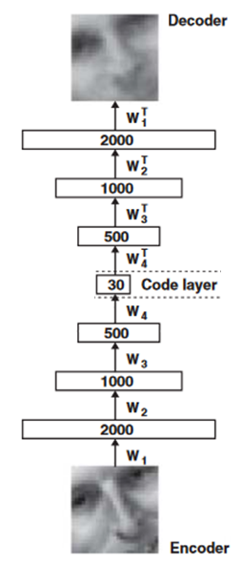
Autoencoder
Train the neural network to reproduce its input vector as its output
This forces it to compress as much information as possible into few numbers in the central bottleneck.
These few (here 30) numbers are then a good way to represent data.

Slide 71
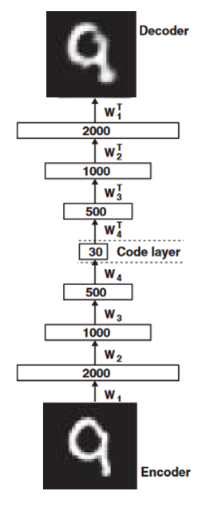
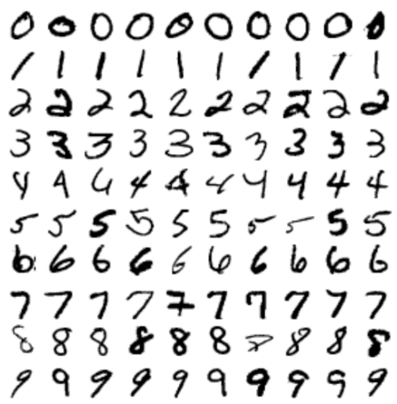
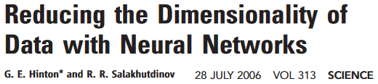
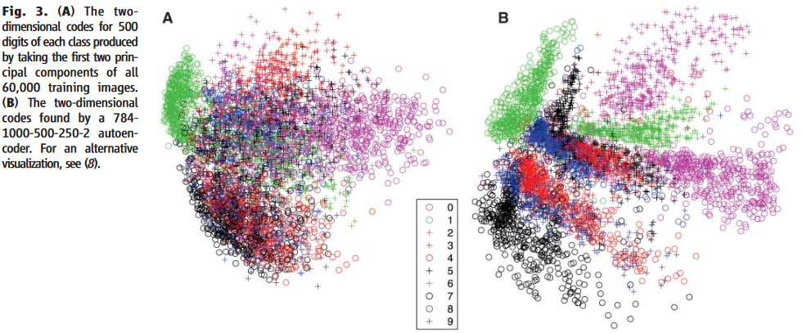
Autoencoder

Slide 72
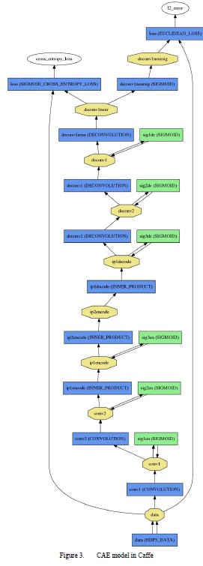

Convolutional Autoencoder
Turchenko & Luczak, IEEE IDAACS 2017

Slide 73

Deep Neuronal Networks
Le et al. (2013) ICASSP, IEEE International Conference
http://theanalyticsstore.ie/deep-learning/

Slide 74

And that’s that
That’s the basic idea
There are many many types of deep learning,
different kinds of autoencoder, variations on architectures and training algorithms, etc…
Very fast growing area …

Slide 75
Thanks
Shangsong Liang
Sun Yat-sen University
liangshangsong@gmail.com

